Slide 1
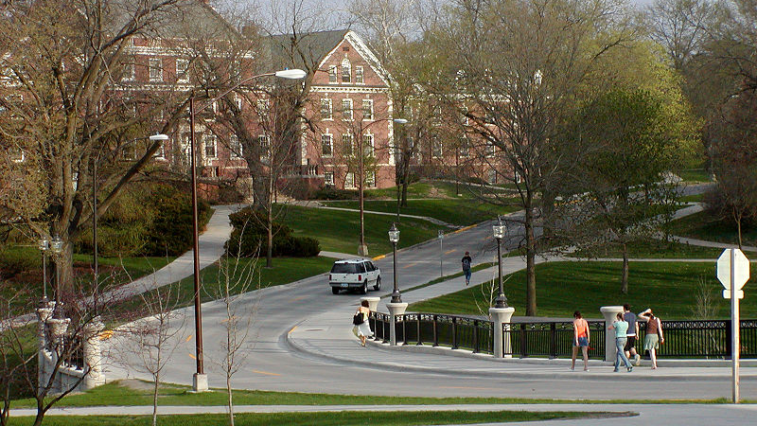
Housing market in Aimes, Iowa
Investing in real estate for students

Slide 2
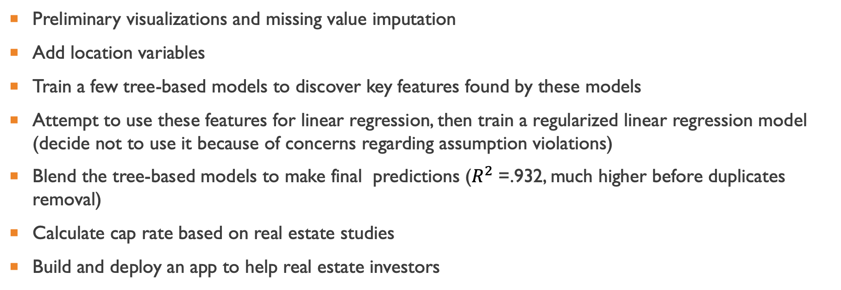
Approach
Preliminary visualizations and missing value imputation
Add location variables
Train a few tree-based models to discover key features found by these models
Attempt to use these features for linear regression, then train a regularized linear regression model (decide not to use it because of concerns regarding assumption violations)
Blend the tree-based models to make final predictions ($R^{2}$ =.932, much higher before duplicates removal)
Calculate cap rate based on real estate studies
Build and deploy an app to help real estate investors

Slide 3
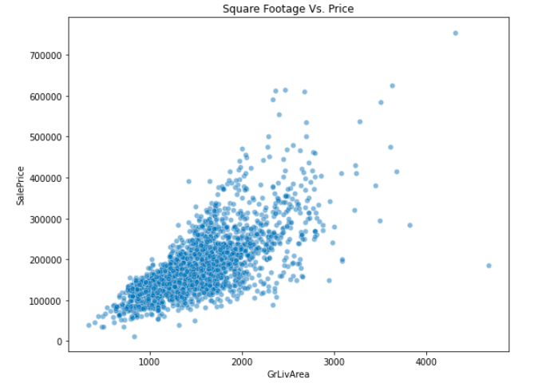
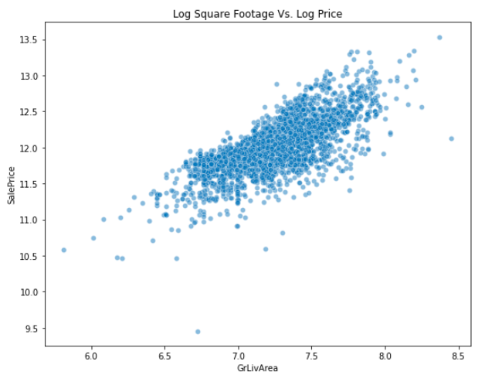
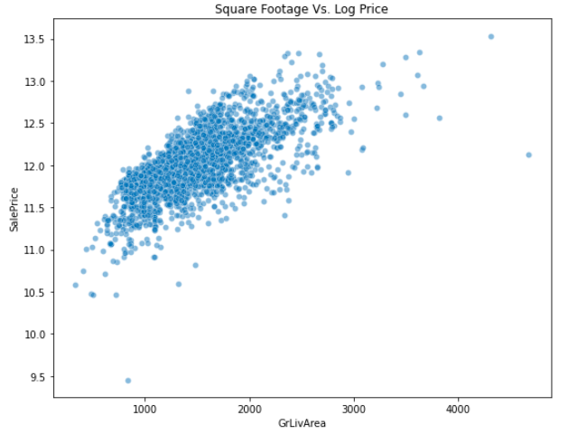
Price vs living area scatter plots
Transforming the independent variable with log is useful to reduce the spread at larger living areas
For ease of interpretation, will use the log-linear form rather than the log-log form for the linear regression model

Slide 4
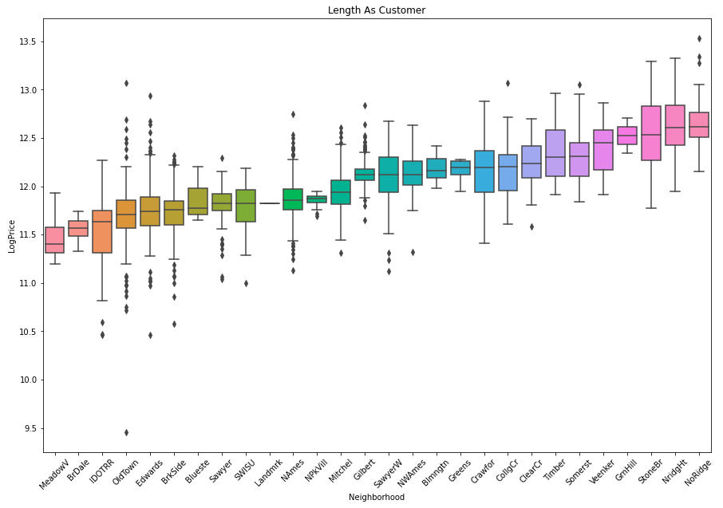
Log prices by neighborhood
Prices vary by neighborhood
This effect will be picked up by the models to different extent
Houses in high median price neighborhoods will end up not being suitable for investing in student housing

Slide 5
Feature importances and models comparison
RFs (R2: .907 on Test Set) | CatBoost (R2:0.92275 (no dupl)/ 0.95 (dupl) on Test Set) | XGBoost (R2: 0.93174/.95(dupl) on Test Set)
OverallQual 0.555752 GrLivArea 0.138248 1stFlrSF 0.051820 TotalBsmtSF 0.030623 GarageArea 0.028397 BsmtFinSF1 0.024851 LotArea 0.011924 2ndFlrSF 0.011556 FullBath 0.011551 GarageCars 0.009987 YearBuilt 0.008160 MasVnrArea 0.006633 | OverallQual 18.754183 GrLivArea 15.497276 1stFlrSF 5.126514 TotalBsmtSF 4.201394 BsmtFinSF1 4.047372 KitchenQual 3.025626 Fireplaces 2.791535 LotArea 2.785231 GarageArea 2.626287 2ndFlrSF 2.542275 YearBuilt 2.440147 GarageCars 2.183048 | OverallQual 0.227648 ExterQual 0.200002 GarageCars 0.161469 KitchenQual 0.053119 BsmtQual 0.040191 GrLivArea 0.029050 Fireplaces 0.024213 YearBuilt 0.022945 CentralAir 0.015570 FullBath 0.015364 GarageArea 0.013840 GarageFinish 0.013713
Quality and living area variables are identified as most important
Year a house was built/remodeled, garage and fireplace variables are also predictive of price
Neighborhood was in the 20’s or 30’s among the feature importances. Why?
Higher quality houses are in more desirable neighborhoods
All models also relied on the more granular latitude and

Slide 6
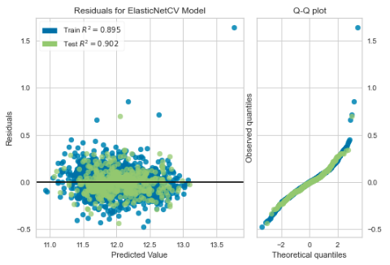
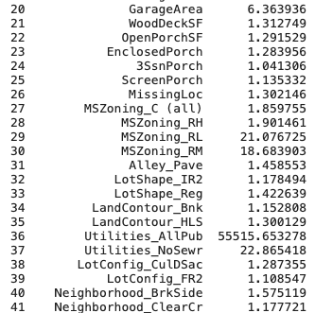
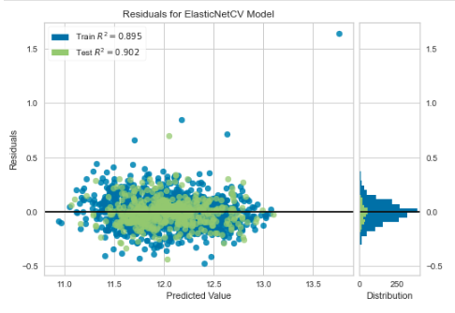
A case against linear regression
The results are for the ElasticNet regression for all features
Residuals deviate from the straight line of the Q-Q plot away from the center
Over half of the features get dropped, yet multicollinearity persists according to VIFs
When variables such as Utilities_AllPub are dropped, VIFs for other nonrelated variables expand

Slide 7
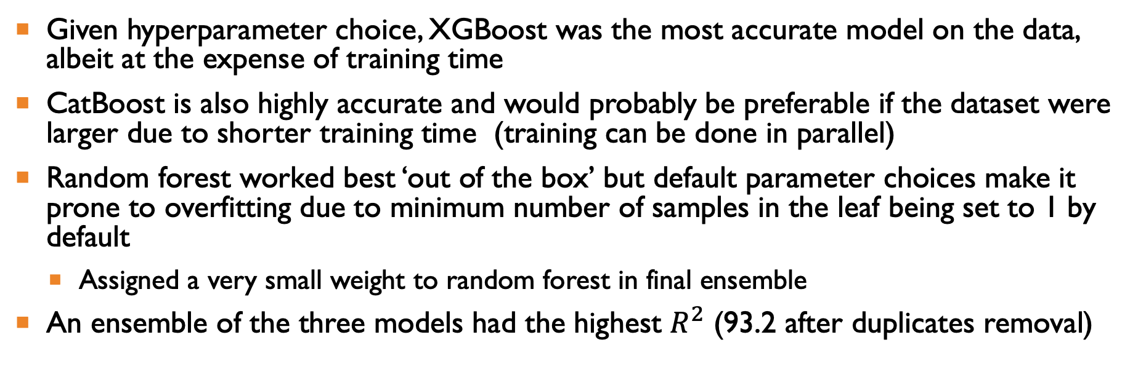
Other model training considerations
Given hyperparameter choice, XGBoost was the most accurate model on the data, albeit at the expense of training time
CatBoost is also highly accurate and would probably be preferable if the dataset were larger due to shorter training time (training can be done in parallel)
Random forest worked best ‘out of the box’ but default parameter choices make it prone to overfitting due to minimum number of samples in the leaf being set to 1 by default
Assigned a very small weight to random forest in final ensemble
An ensemble of the three models had the highest $R^{2}$ (93.2 after duplicates removal)

Slide 8
Calculating net operating income Factors
First, must determine the yearly costs as a percentage of house price
Taxes: 1.5%
Maintenance costs: 2%
Insurance: 0.6%
Miscellaneous fees (legal, property management, etc.): 3%
Include the distance premium
29% for distance under .5 miles from campus (adjusted by .3 miles for campus size)
5% for distance between .5 miles and 1 mile from campus (adjusted by .3 miles for campus size)
Account for vacancy rates
1.7% for properties under .5 miles from campus (adjusted by .3 miles for campus size)
2.5% for distance between .5 miles and 1 mile from campus (adjusted by .3 miles for campus size)
7% for houses 1 mile from campus or higher
Observe that all these factors, as well as factors that determined the price prediction, will have an impact on profitability from student rentals.

Slide 9
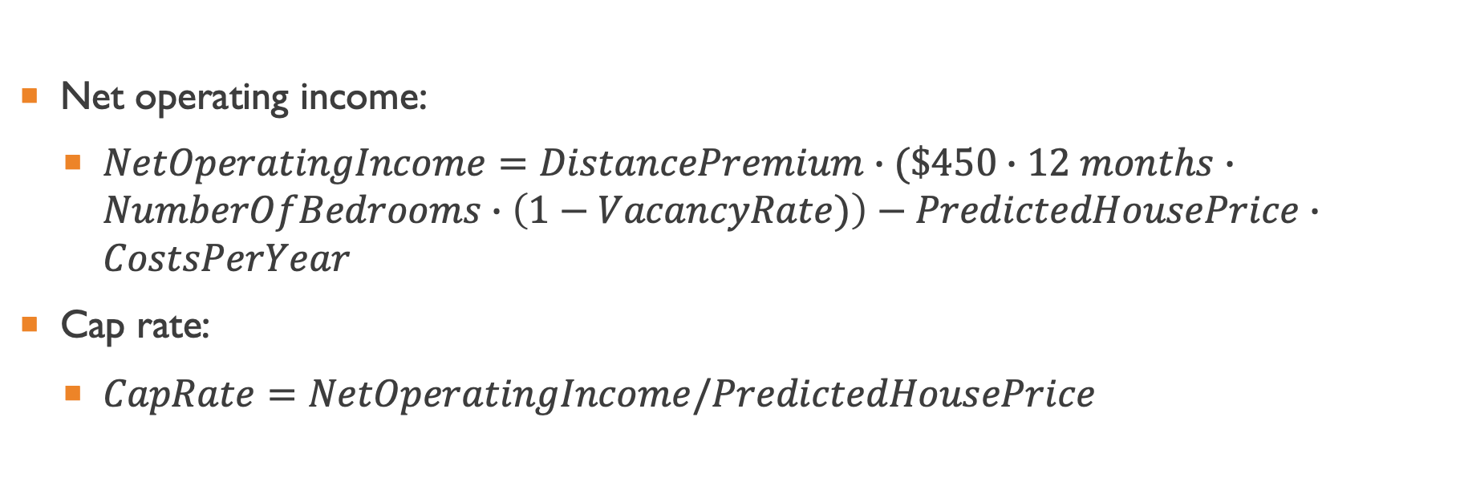
calculating Net operating income and cap rates
Net operating income:
$NetOperatingIncome=DistancePremium∙(\$450∙12 months∙NumberOfBedrooms∙\left(1−VacancyRate)\right)−PredictedHousePrice∙CostsPerYear$
Cap rate:
$CapRate=NetOperatingIncome/PredictedHousePrice$

Slide 10
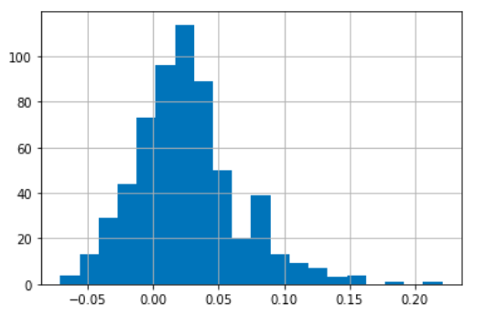
Returns distribution
Distribution of returns is consistent with average returns on student housing being in the range between 7 and 18%
https://www.bbc.com/worklife/article/20160420-making-money-from-students,
Consult with real estate professionals before using the model in production

Slide 11
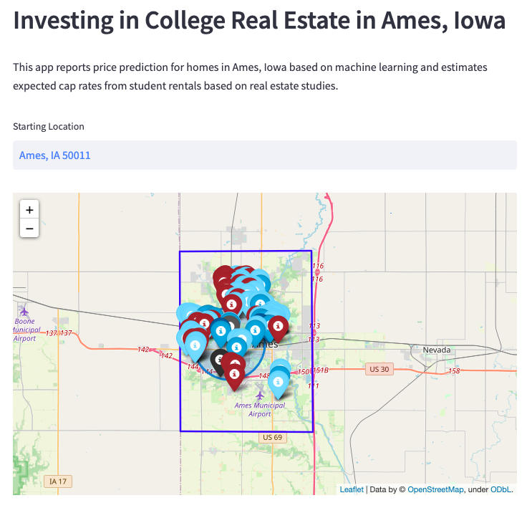
Investment helper Web app
Deployed at https://ames-app.herokuapp.com/
20% subsampled from the test set to reduce clutter
Predictions and locations stored in a data frame to reduce latency
Most lucrative real estate is often located closer to campus
Expensive houses in posh neighborhoods often show up in red due to lower suitability for student housing

Slide 12
Future work
Consult with real estate agents regarding refining the NOI and cap rate calculations
Could we get higher returns by partitioning the houses into rooms?
Cost could be overestimated
Build a more sophisticated app permitting identification of factors that could lead to greatest cap rate improvement for each house
For ease of interpretability, could use the best performing model’s (XGBoost) Shap values for this analysis
Try overlaying neighborhoods on the map using GeoJSON to better highlight the neighborhood effect
Identify a database with telephone numbers and add these to the app for realtor’s convenience

Slide 13

Appendix

Slide 14
Feature importances and models comparison
RFs (R2: .907 on Test Set) | CatBoost (R2:0.92275 (no dupl)/ 0.95 (dupl) on Test Set) | XGBoost (R2: 0.93174/.95(dupl) on Test Set)
OverallQual 0.555752 GrLivArea 0.138248 1stFlrSF 0.051820 TotalBsmtSF 0.030623 GarageArea 0.028397 BsmtFinSF1 0.024851 LotArea 0.011924 2ndFlrSF 0.011556 FullBath 0.011551 GarageCars 0.009987 YearBuilt 0.008160 MasVnrArea 0.006633 YearRemodAdd 0.006391 lats 0.005636 LotFrontage 0.005449 KitchenQual 0.005060 longs 0.005030 OverallCond 0.004534 BsmtUnfSF 0.004444 GarageFinish 0.004428 | OverallQual 18.754183 GrLivArea 15.497276 1stFlrSF 5.126514 TotalBsmtSF 4.201394 BsmtFinSF1 4.047372 KitchenQual 3.025626 Fireplaces 2.791535 LotArea 2.785231 GarageArea 2.626287 2ndFlrSF 2.542275 YearBuilt 2.440147 GarageCars 2.183048 YearRemodAdd 2.048334 OverallCond 1.775863 BsmtQual 1.716422 ExterQual 1.515279 GarageType 1.418953 FullBath 1.385398 GarageYrBlt 1.384613 HalfBath 1.312559 | OverallQual 0.227648 ExterQual 0.200002 GarageCars 0.161469 KitchenQual 0.053119 BsmtQual 0.040191 GrLivArea 0.029050 Fireplaces 0.024213 YearBuilt 0.022945 CentralAir 0.015570 FullBath 0.015364 GarageArea 0.013840 GarageFinish 0.013713 1stFlrSF 0.013117 TotalBsmtSF 0.012377 GarageType 0.012039 MissingLoc 0.010694 BsmtFinSF1 0.009349 MSZoning 0.007960 OverallCond 0.007506 2ndFlrSF 0.006749
Quality and living area variables are identified by tree models as most important
Year a house was built or remodeled as well as variables pertaining to garage are also predictive of price
Neighborhood was in the 20’s or 30’s among the feature importances, but all models also relied on the more granular latitude and longitude variables and perhaps the quality variables picked up the neighborhood effects (higher quality houses being in more desirable neighborhoods)

Slide 15
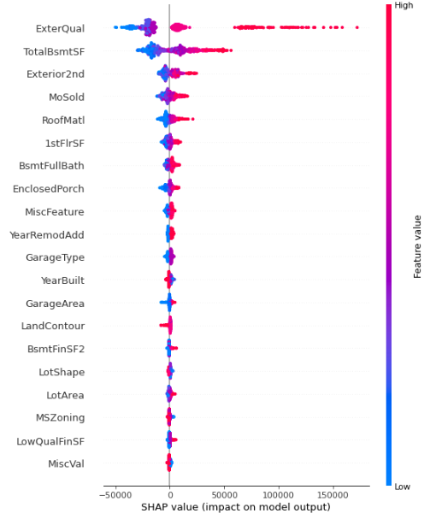
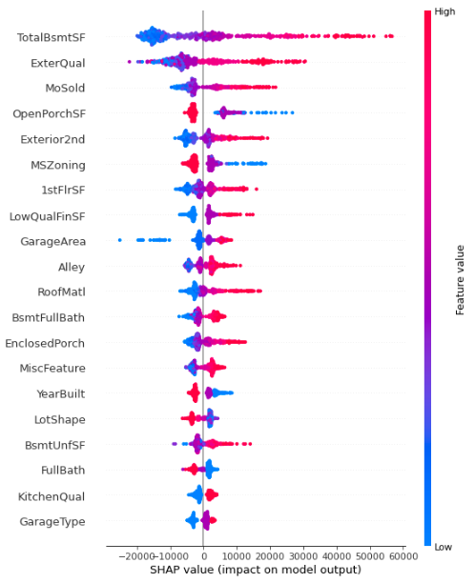
rfs, xgb,Catboost shap values
Are SHAP values trustworthy? Perhaps not for these models?
See: arXiv:2002.11097 [cs.AI]

Slide 16
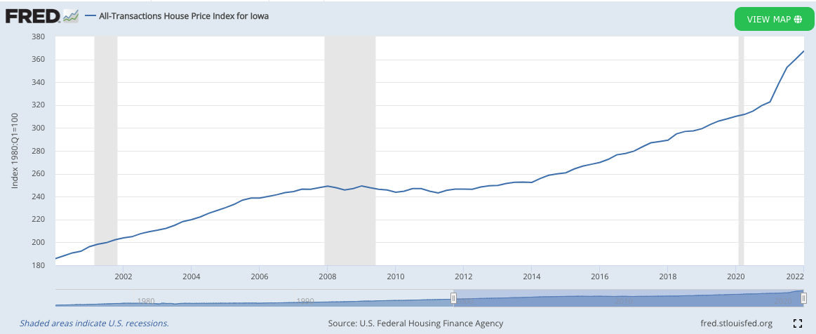
Fred house price index
Prices stayed relatively constant during the crisis, helping future generalizability of the analyses
Source: https://fred.stlouisfed.org/series/IASTHPI

Slide 17
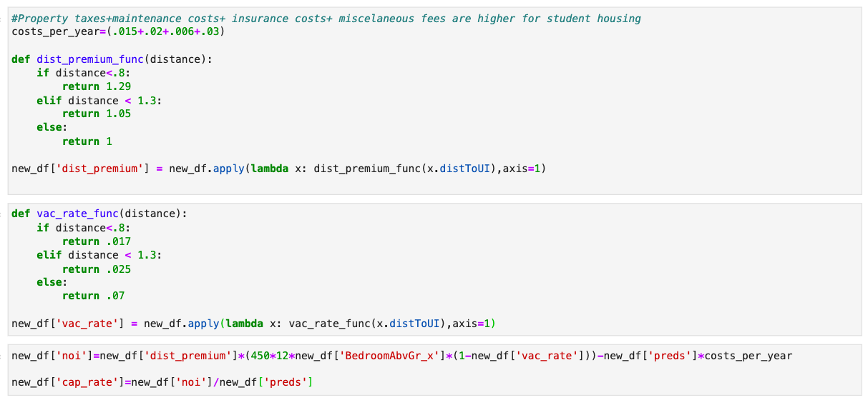
CAP rate calculation details

Slide 18
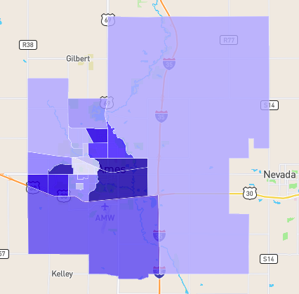
Ames crime map

Slide 19
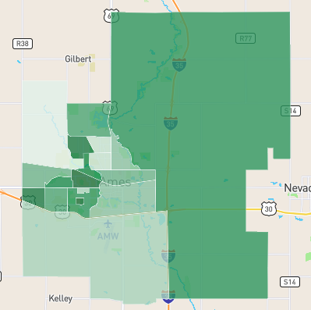
Ames property prices map

Slide 20
Log prices by neighborhood
Prices vary by neighborhood
This effect will be picked up by the models
By comparing with the slide below, it is clear that some of the neighborhoods are not suited for student rentals
See Northridge and Northridge Heights, for example

Slide 21
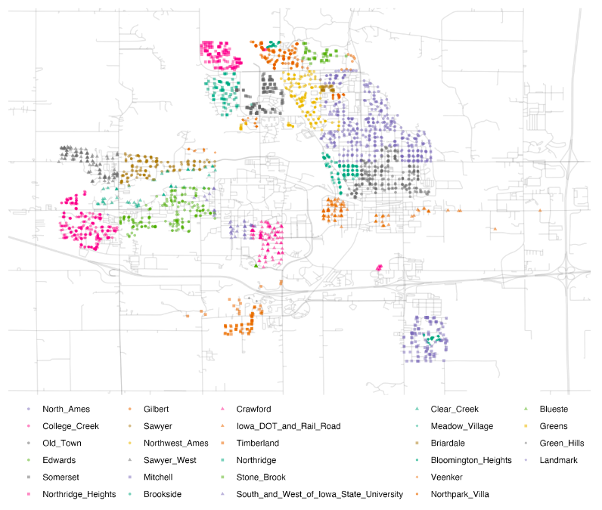
Ames Neighborhoods
Source: https://www.tmwr.org/ames.html

Slide 22
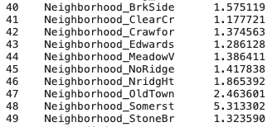
Neighborhood coefficient for regularized linear regression
Just as for tree models, these coefficients are small
Effects probably absorbed by other variables

Slide 23
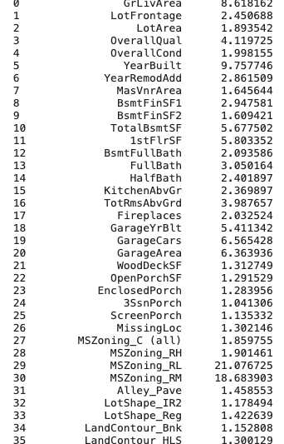
A case against linear regression
Residuals deviate from the straight line of the Q-Q plot away from the center
The results are for the ElasticNet regression for all features
Over half of the features get dropped, yet multicollinearity persists according to VIFs
When variables such as Utilities_AllPub are dropped, VIFs for other nonrelated variables expand

Slide 24
REsources
How to calculate NOI:
https://www.investopedia.com/terms/n/noi.asp
How to calculate cap rate using NOI:
https://www.investopedia.com/terms/c/capitalizationrate.asp
Renting houses in Ames, Iowa (approximately $450-500/room):
https://www.zillow.com/ames-ia/rent-houses/
Proximity to campus and rent premium growth:
https://www.realpage.com/analytics/top-performing-student-housing-trending-closer-campus/

Slide 25
REsources
Vacancy rate data:
https://www.statista.com/statistics/913457/vacancy-rate-student-housing-units-usa/ and
https://www.neighborhoodscout.com/ia/ames/real-estate
Insurance data:
https://www.bankrate.com/insurance/homeowners-insurance/iowa/
Premium based on distance from campus estimated using https://www.statista.com/statistics/1281943/rent-of-student-housing-by-distance-from-campus/

